Slide 1
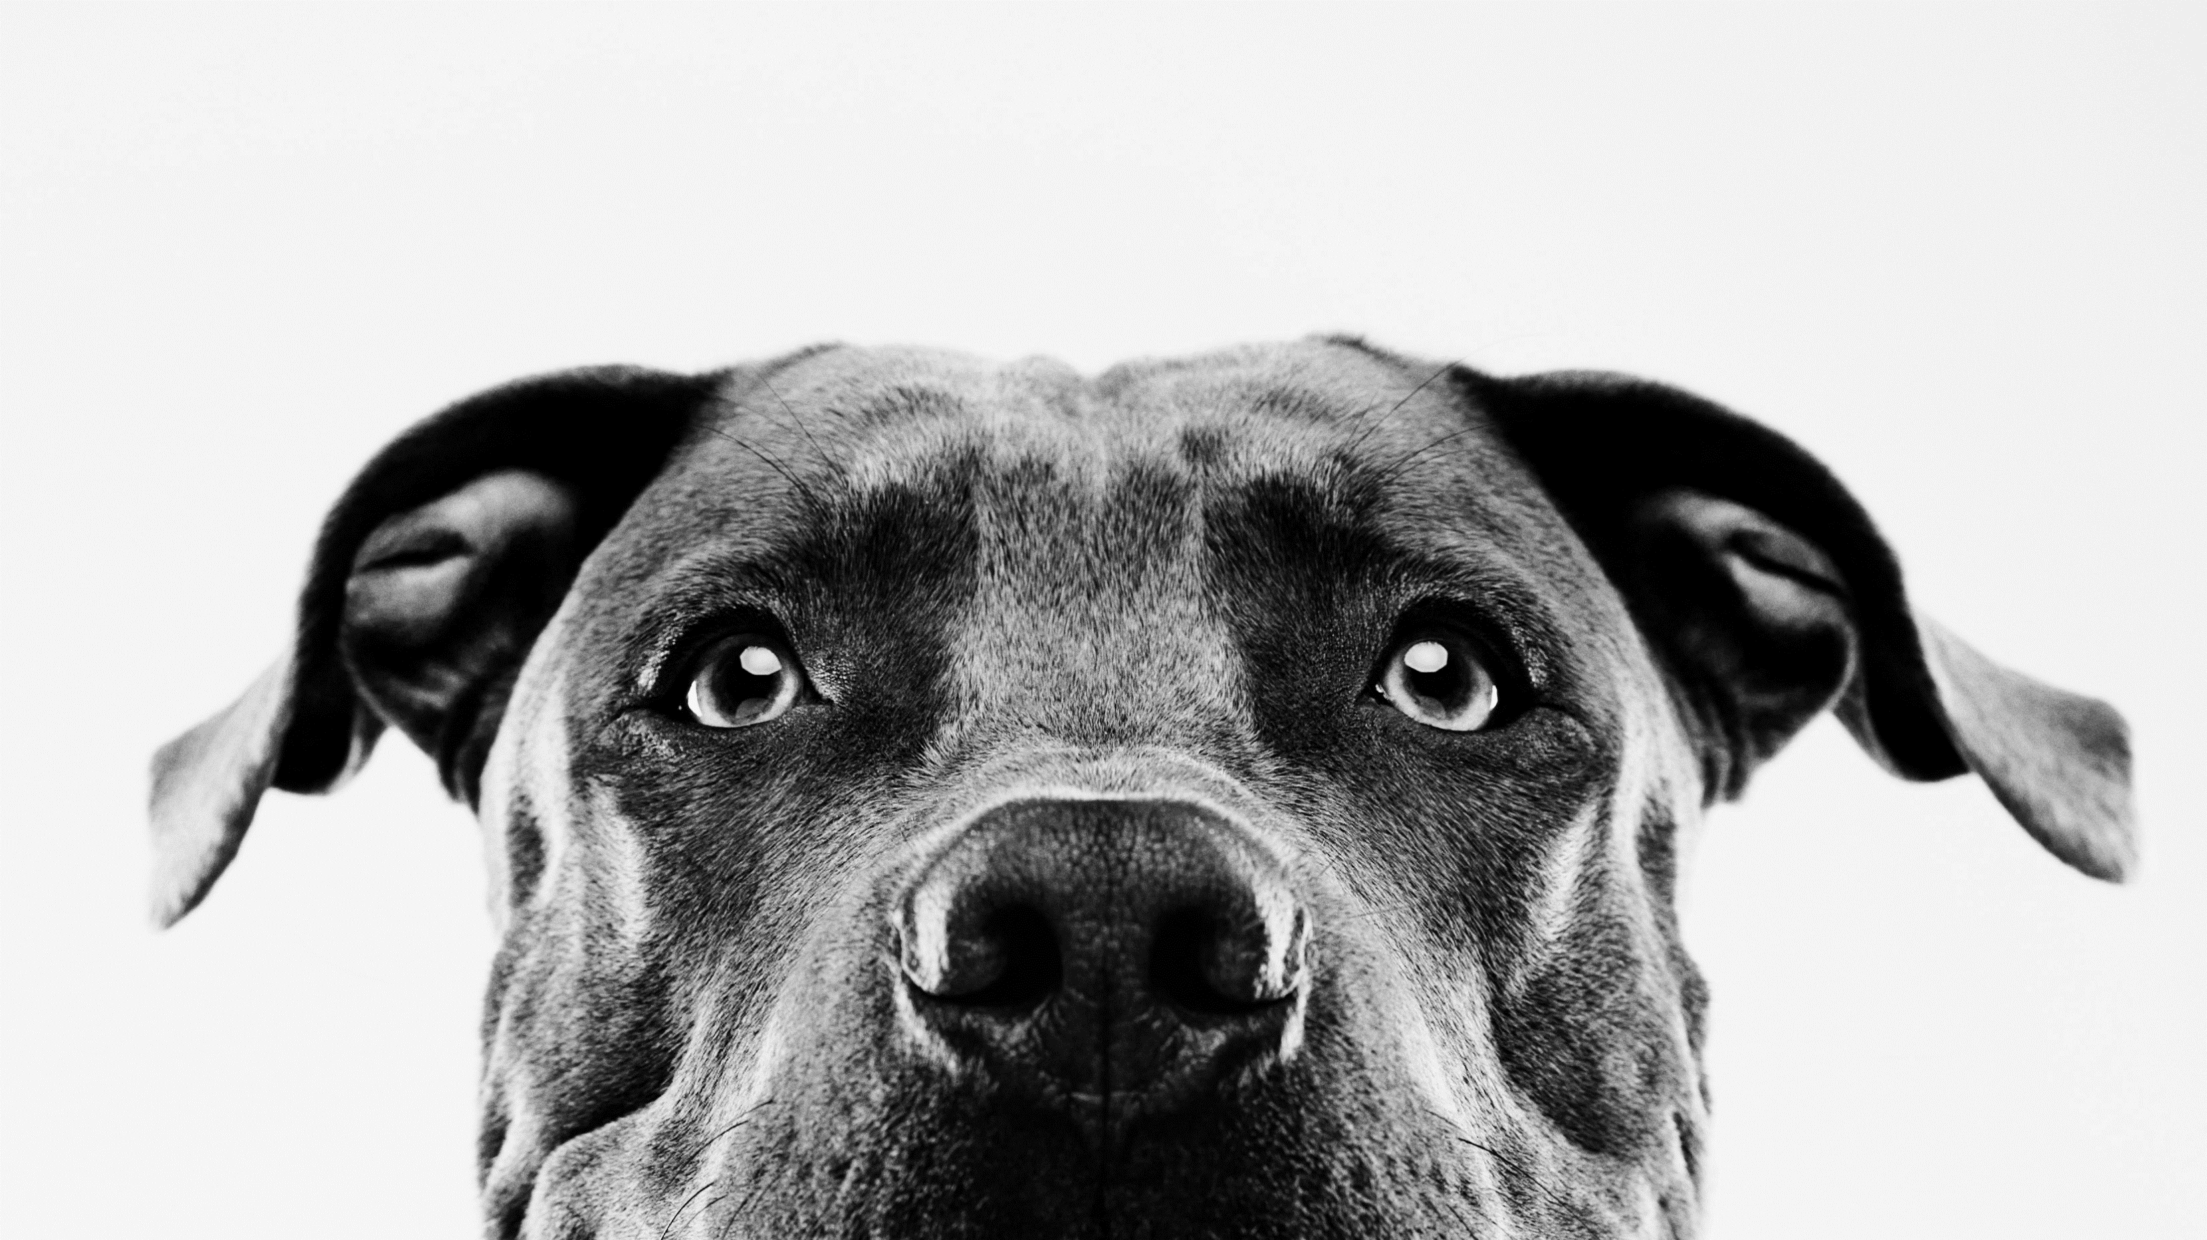
Pet adoption predictions
Mark Pasricha – lead developer
Melissa hazelgreen – Senior analyst
Kristin Aspromonti – project manager

Slide 2
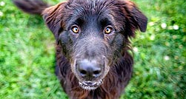
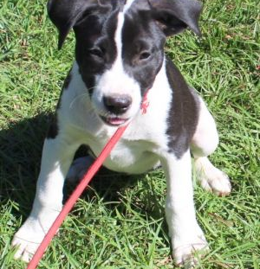
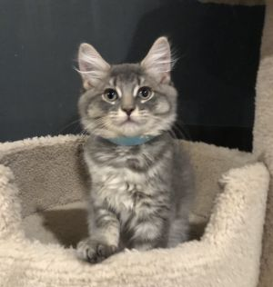
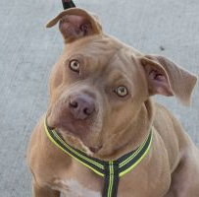

Slide 3
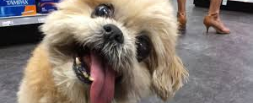
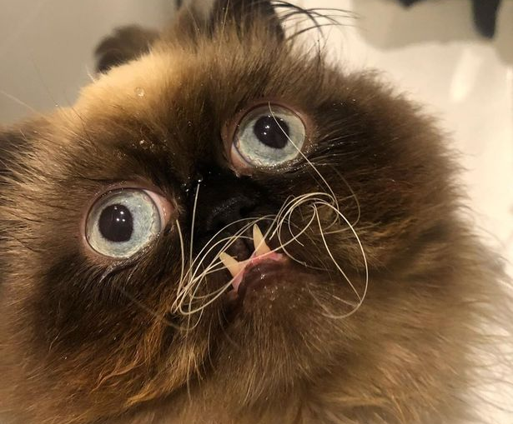
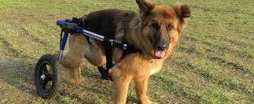
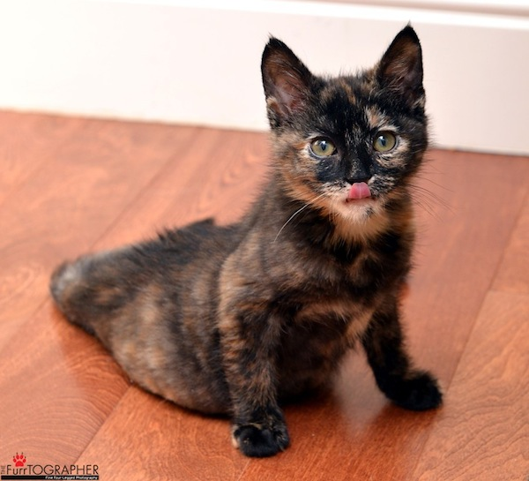

Slide 4
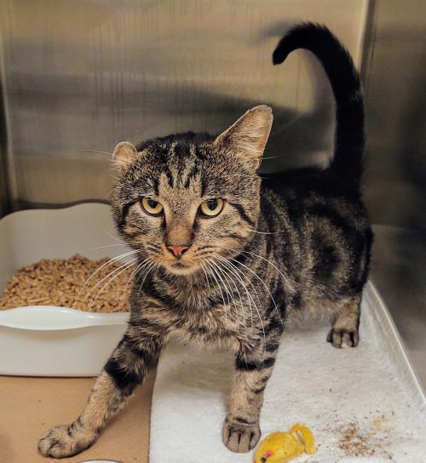
Objective
TO positively influence Adoption outcomes FOR ANIMALS THAT ARE LEAST LIKELY TO BE ADOPTED

Slide 5
ETL
MODEL
PREDICT
RESOURCES
Kaggle
Petfinder API
DEPENDENCIES
Jupyter Notebook
Pandas
Tensorflow
Sklearn
Sqlalchemy
Flask
OAuth2
Requests
Plotly
LANGUAGES
Python
JavaScript
HTML
SQL
Notes:
What was interesting about the flow of this project was how it evolved over time. It began with a simple dataset. They had provided both test and training data, pictures, metadata and the encoded files. After running that through several models we were getting pretty low scores.

Slide 6


our story
Original dataset from a Kaggle competition
Tested various models – returned low scores
API to Petfinder.com to supplement data
Simultaneously running ML on API and Kaggle
Developed a website that will return the predicted adoption of an animal
Notes:
What was interesting about the flow of this project was how it evolved over time. It began with a simple dataset. They had provided both test and training data, pictures, metadata and the encoded files. After running that through several models we were getting pretty low scores.

Slide 7
The process
Notes:
What was interesting about the flow of this project was how it evolved over time. It began with a simple dataset. They had provided both test and training data, pictures, metadata and the encoded files. After running that through several models we were getting pretty low scores.

Slide 8
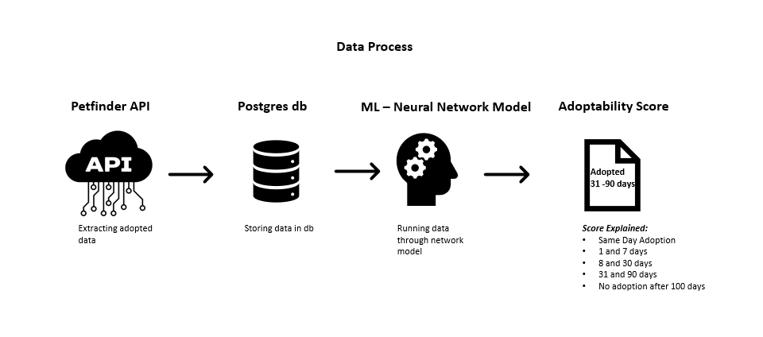

Slide 9
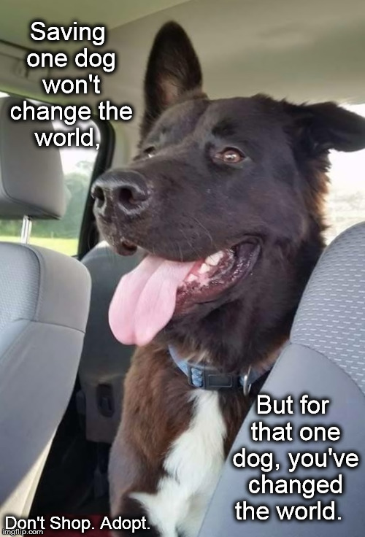
How can this info help?
Introducing the benefits of data and analytics to the process
Marketing strategies can be formulated around the dogs with the lowest scores.
Fostering initiatives implemented to maximize the likelihood of adoption
Mange shelter capacity
Notes:
What was interesting about the flow of this project was how it evolved over time. It began with a simple dataset. They had provided both test and training data, pictures, metadata and the encoded files. After running that through several models we were getting pretty low scores.

Slide 10
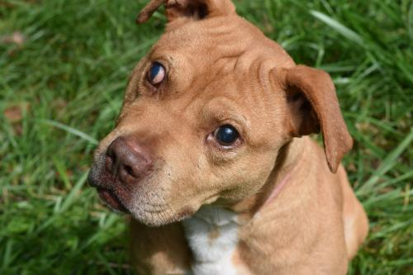
Machine learning

Slide 11
Y Data (Outcome)
Adoption Speed — Categorical speed of adoption. Lower is faster. This is the value to predict. See below section for more info.
X Data (Features)
Type — Type of animal (1 = Dog, 2 = Cat)
Age — Age of pet when listed, in months
Breed1 — Primary breed of pet
Breed2 — Secondary breed of pet, if pet is of mixed breed
Gender — Gender of pet (1 = Male, 2 = Female, 3 = Mixed, if profile represents group of pets)
Color1 — Primary color
Color2 — Secondary color
Color3 — Tertiary color
Maturity Size — Size at maturity (1 = Small, 2 = Medium, 3 = Large, 4 = Extra Large, 0 = Not Specified)
Maturity Size — Size at maturity (1 = Small, 2 = Medium, 3 = Large, 4 = Extra Large, 0 = Not Specified)
Fur Length — Fur length (1 = Short, 2 = Medium, 3 = Long, 0 = Not Specified)
Vaccinated — Pet has been vaccinated (1 = Yes, 2 = No, 3 = Not Sure)
Dewormed — Pet has been dewormed (1 = Yes, 2 = No, 3 = Not Sure)
Sterilized — Pet has been spayed / neutered (1 = Yes, 2 = No, 3 = Not Sure)
Health — Health Condition (1 = Healthy, 2 = Minor Injury, 3 = Serious Injury, 0 = Not Specified)
Fee — Adoption fee (0 = Free)
Video Amt — Total uploaded videos for this pet
Photo Amt — Total uploaded photos for this pet

Slide 12
Demo
Prediction
What options are 1-7 day, 8-30, 31-90, over 100
Using Nerual Network
b/c knn – low score vs log reg
Random forrest
Neural Network.
250 epochs sweet spot
Compare Kaggle vs api dataset and how they are testing
Hoping Additional features we can pull live will + impa

Slide 13
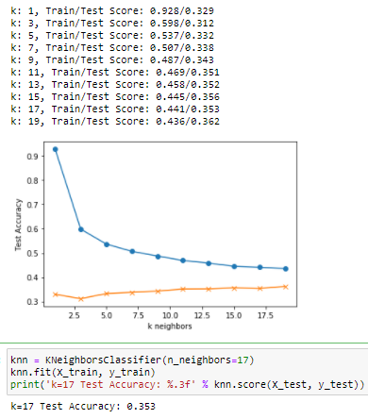
Model testing
KNN Model
Logistical Regression

Slide 14
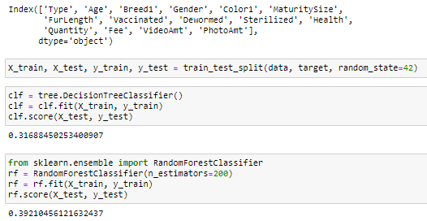
Model testing
Random Forrest
Features
0.14741186964735833, 'PhotoAmt',
0.1384766037034141, 'Age',
0.08720990747064314, 'Color2',
0.08619369519743096, 'Color1',
0.07978128044193844, 'Breed1',
0.05670749658762525, 'Breed2',
0.04668041534450266, 'Gender',
0.04610776610487081, 'FurLength',
0.044909854872647516, 'Quantity',
0.0435481770743158, 'MaturitySize',
0.04310818288981375, 'Fee',
0.04267356603221559, 'Color3',
0.03709335544122785, 'Dewormed',
0.034460276487706214, 'Vaccinated',
0.03262714745250069, 'Sterilized',
0.012845234338030878, 'VideoAmt',
0.010980521552933506, 'Health',
0.00918464936082452, 'Type'

Slide 15
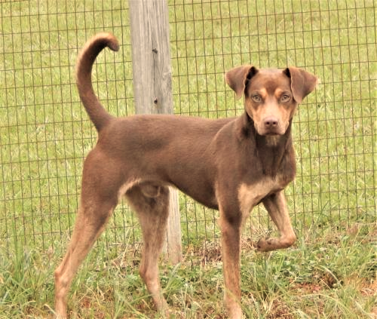
SITE DEMO/code

Slide 16
Future plans
Fully implement and run API Dataset
Store the user input data to feed the model
Update statuses on pets so that data can be used to train the model
Reading pictures in as additional features
Enhanced web design and features
Notes:
What was interesting about the flow of this project was how it evolved over time. It began with a simple dataset. They had provided both test and training data, pictures, metadata and the encoded files. After running that through several models we were getting pretty low scores.

